Slide 1
What is fundraising?

Slide 2
fundraising- (noun) the raising of assets and resources from various sources for the support of an organization or a specific project.
- The Association of Fundraising Professionals Fundraising Dictionary Online

Slide 3
Things to have in place before you start:
Organizational budget
Non-profit tax status
A donor tracking database
A system to quickly acknowledge donations and donors
Individuals (staff, board, volunteers) who are trained in how to ask for money
Knowledge of available funding sources
Basic materials about the organization
Firm knowledge of who you are
Clarity and agreement about how the funds will be used

Slide 4
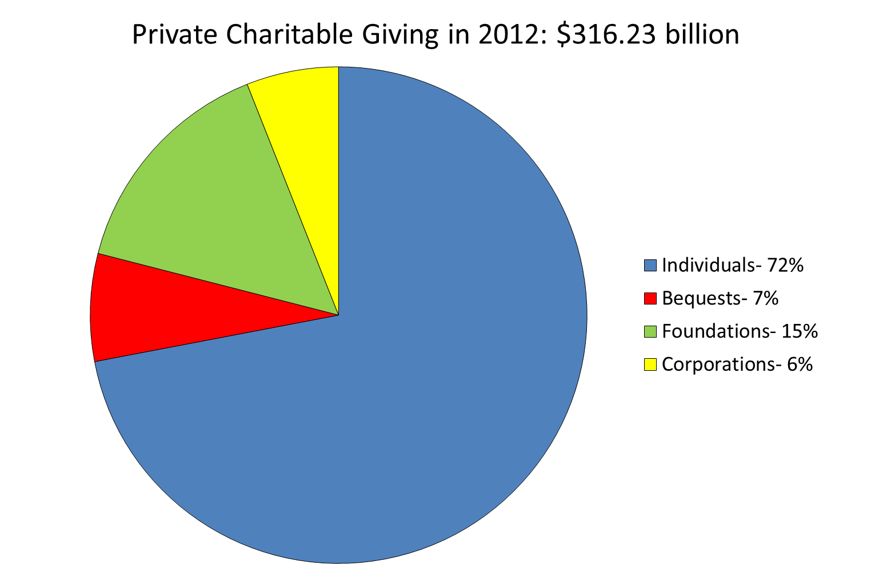
Source: GivingUSA 2013 Highlights
(www.givingusareports.org/2013)

